Slide 1



AWS Overview
-Ayush

Slide 2
What is Cloud Computing?
Cloud computing is a term referred to storing and accessing data over the internet. It doesn't store any data on the hard disk of your personal computer. In cloud computing, you can access data from a remote server.

Slide 3
What is AWS?
Amazon web service is a platform that offers flexible, reliable, scalable, easy-to-use and cost-effective cloud computing solutions.
AWS is a comprehensive, easy to use computing platform offered Amazon. The platform is developed with a combination of infrastructure as a service (IaaS), platform as a service (PaaS) and packaged software as a service (SaaS) offerings.

Slide 4
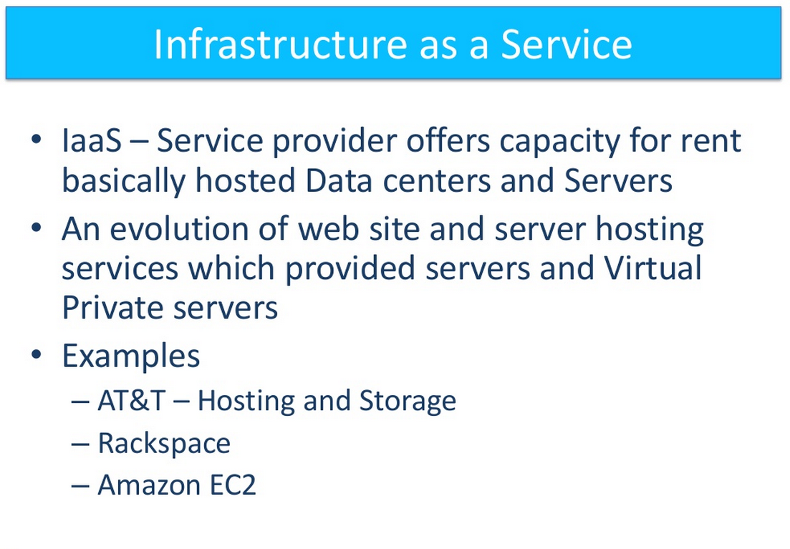
IaaS – Infrastructure as a Service

Slide 5
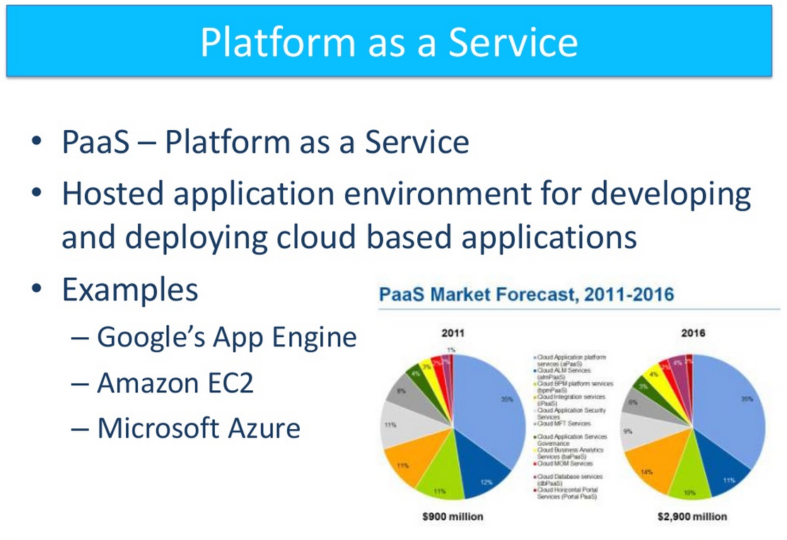
PaaS – Platform as a Service

Slide 6
About Amazon Web Services
Amazon Web Services offers a wide range of different business purpose global cloud-based products. The products include storage, databases, analytics, networking, mobile, development tools, enterprise applications, with a pay-as-you-go pricing model.

Slide 7
Amazon Web Services(AWS) is a cloud service from Amazon, which provides services in the form of building blocks, these building blocks can be used to create and deploy any type of application in the cloud.
Amazon Web Services offers a broad set of global compute, storage, database, analytics, application, and deployment services that help organizations move faster, lower IT costs, and scale applications.
You pay for your virtual server only while it runs, with no up-front purchase costs or ongoing maintenance costs.

Slide 8
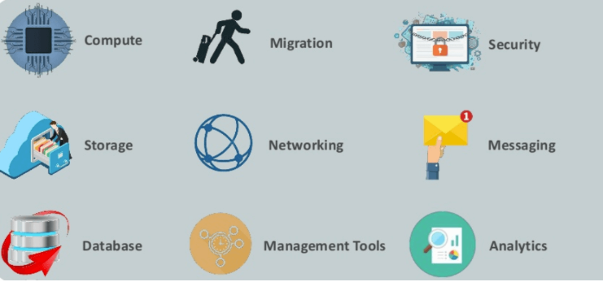

Slide 9
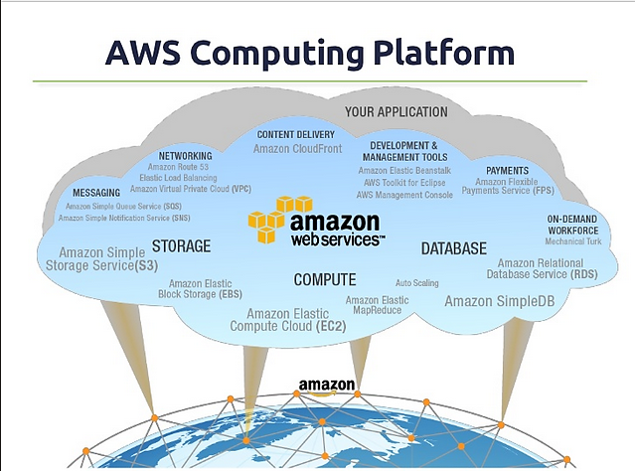
AWS Computing Platform

Slide 10
Why to Choose AWS?
AWS allows organizations to use the already familiar programming models, operating systems, databases, and architectures.
AWS is designed to allow application providers, ISVs, and vendors to quickly and securely host your applications.
You can use the AWS Management Console or well-documented web services APIs to access AWS's application hosting platform.
It is a cost-effective service that allows you to pay only for what you use, without any up-front or long-term commitments.
You will not require to spend money on running and maintaining data centers.
Offers fast deployments
You can easily add or remove capacity.
You are allowed cloud access quickly with limitless capacity.
Total Cost of Ownership is very low compared to any private/dedicated servers.
Offers Centralized Billing and management
Allows you to deploy your application in multiple regions around the world with just a few clicks

Slide 11
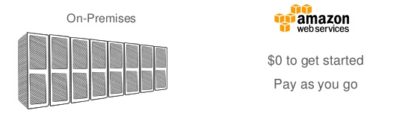
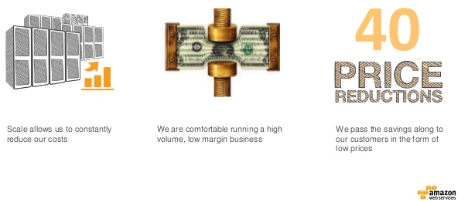
Benefits of using AWS
Pay for Infrastructure as you need it, not Up-front.
Lower Total Cost of IT.

Slide 12
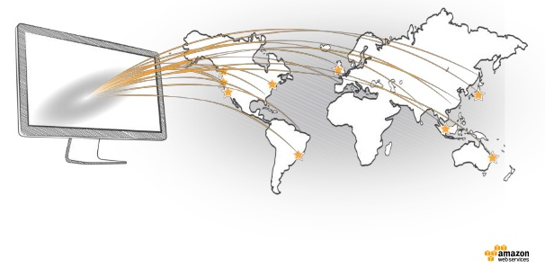
Benefits of using AWS Continued….
Go Global in Minutes

Slide 13
Architecture
AWS is located in 18 geographical "regions“.
US East (Northern Virginia)
US West (northern California)
US West (Oregon)
Brazil (São Paulo)
Europe (Ireland)
South Asia (Singapore)
East Asia (Tokyo)
Australia (Sydney)
Each Region is wholly contained within a single country and all its data and services stay within the designated Region.
Each Region has multiple "Availability Zones", which are distinct data centers providing AWS services.
Availability Zones are isolated from each other to prevent outages from spreading between Zones

Slide 14
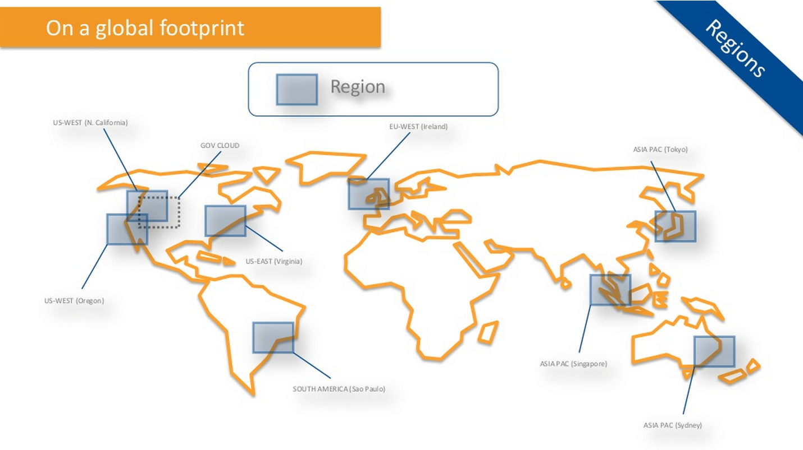
Regions

Slide 15
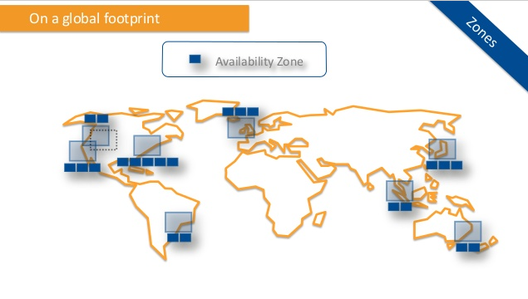
Availability Zones

Slide 16
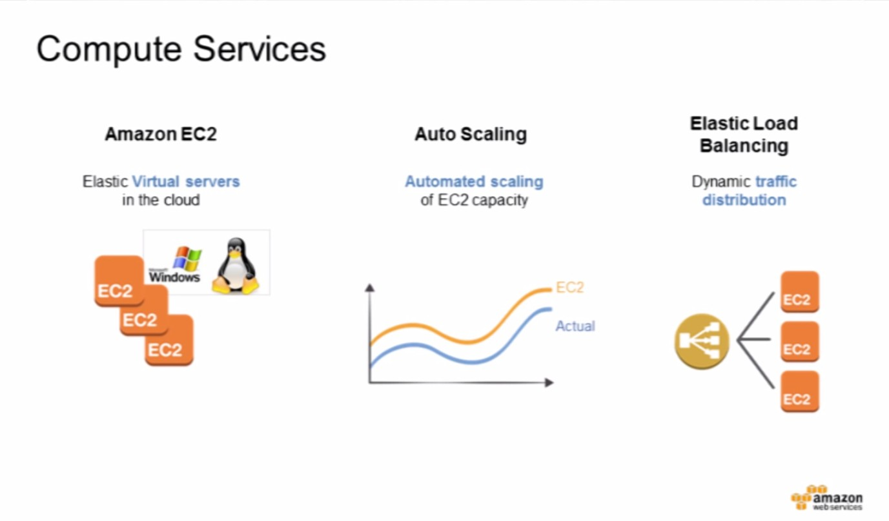
Products & Services

Slide 17
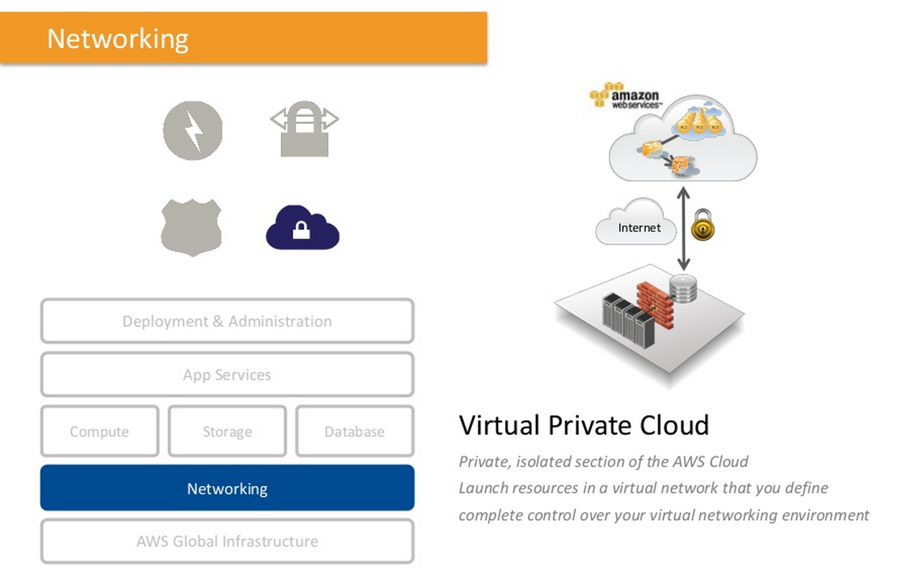
Virtual Private Cloud (VPC)

Slide 18
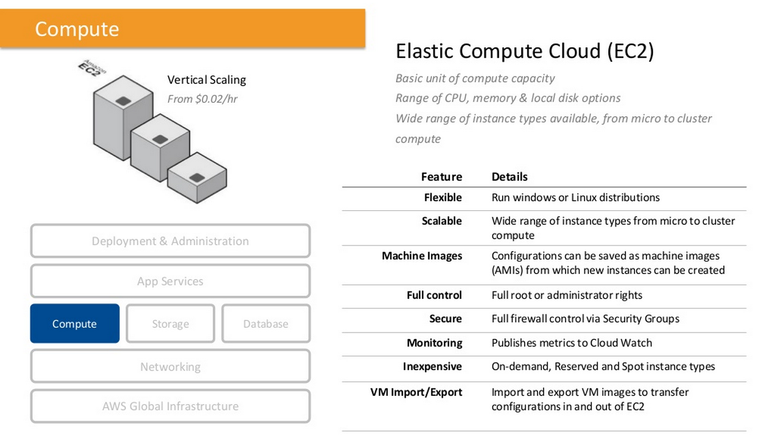
EC2

Slide 19
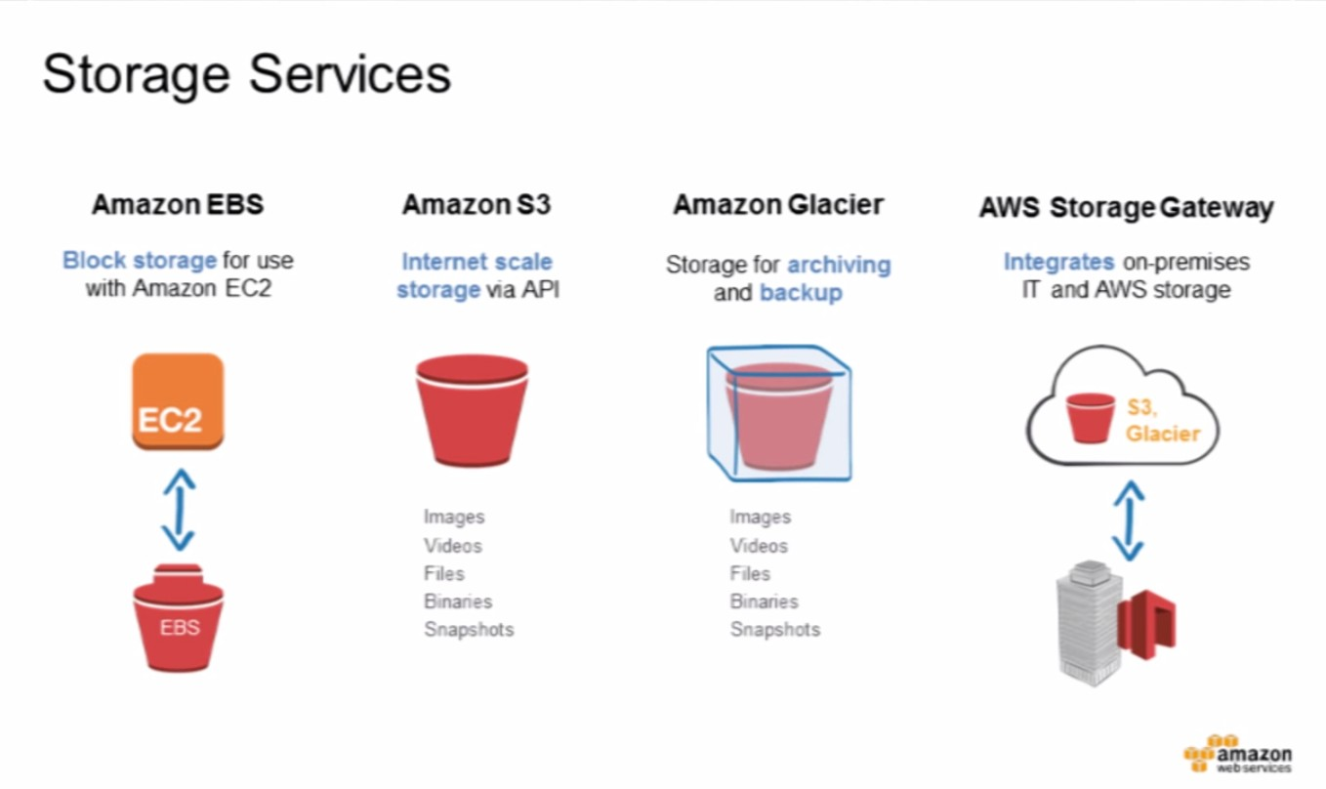

Slide 20
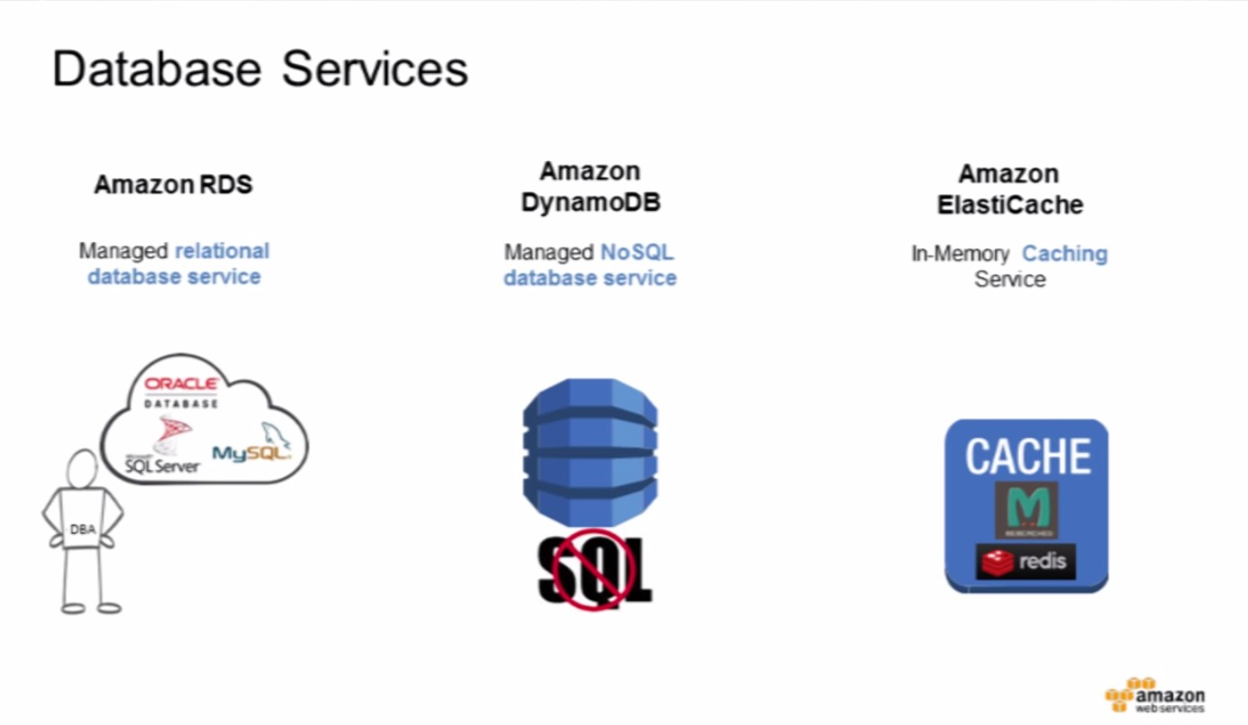

Slide 21
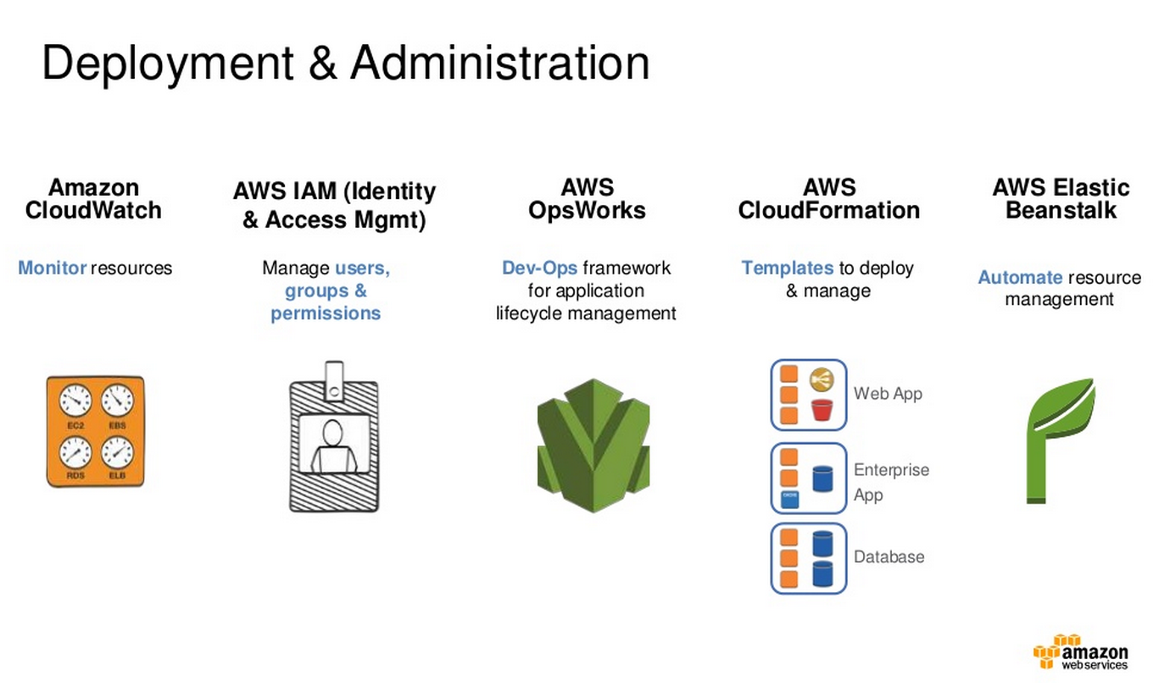

Slide 22
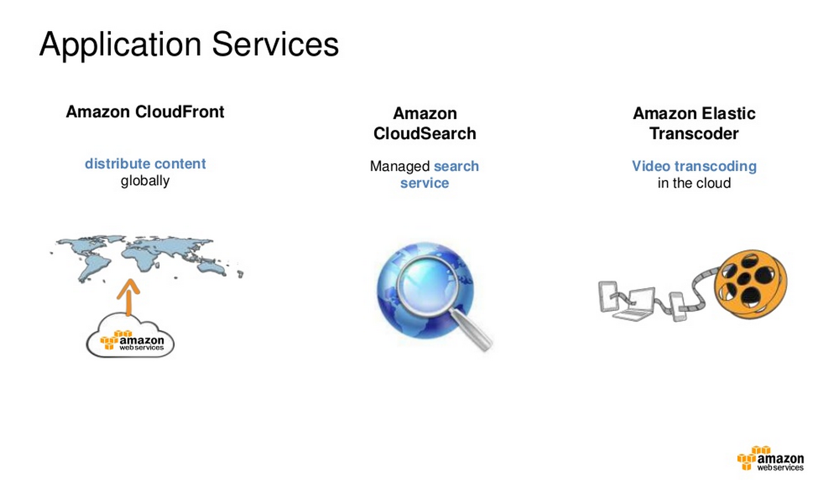

Slide 23
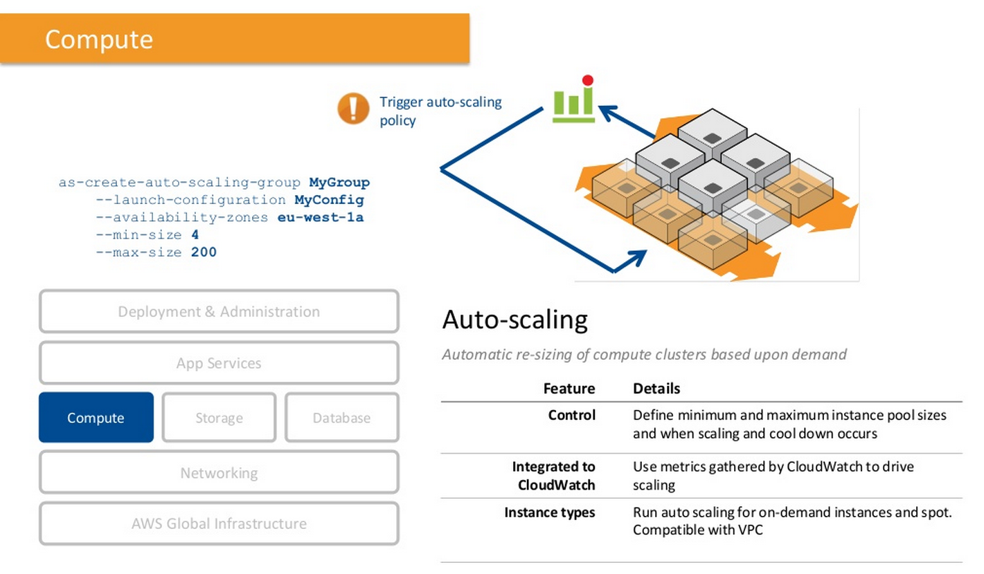
Auto Scaling

Slide 24
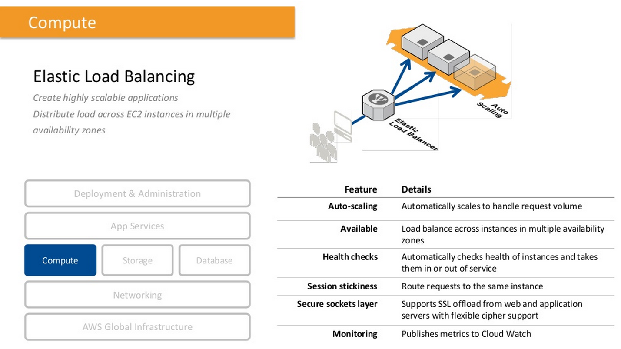
Elastic Load Balancer

Slide 25
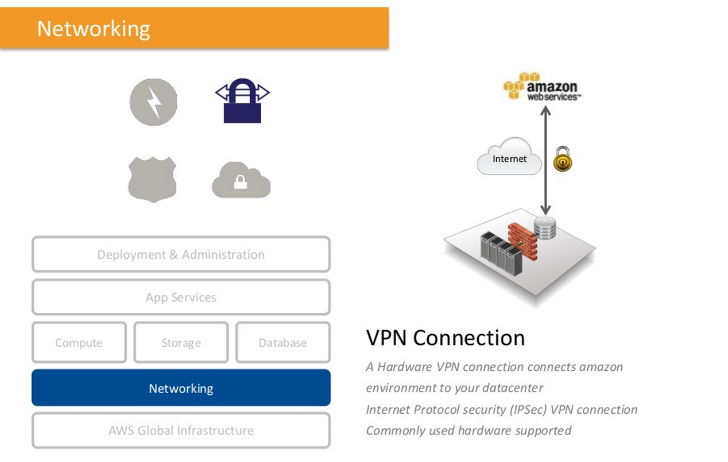
Virtual Private Network Connection (VPN)

Slide 26
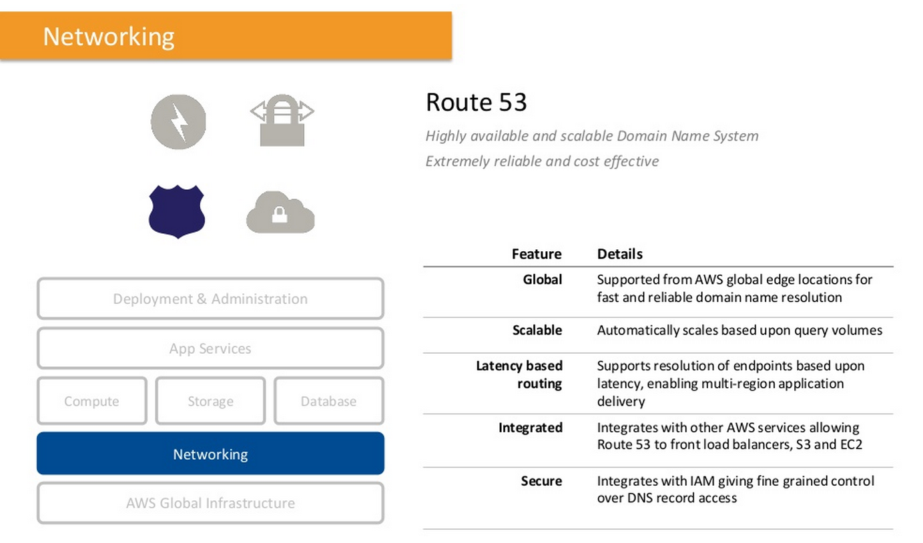
Route 53

Slide 27
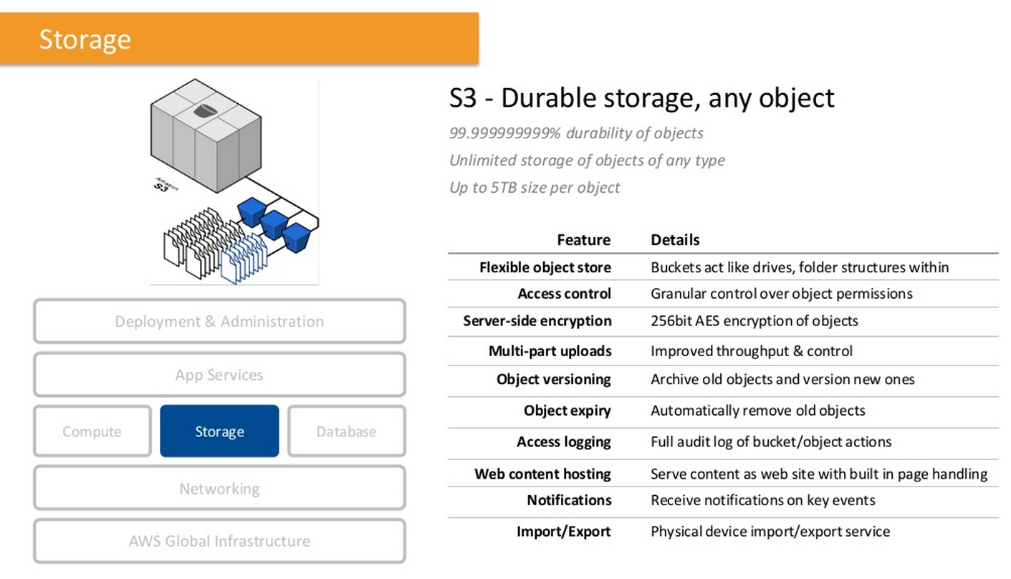
S3

Slide 28
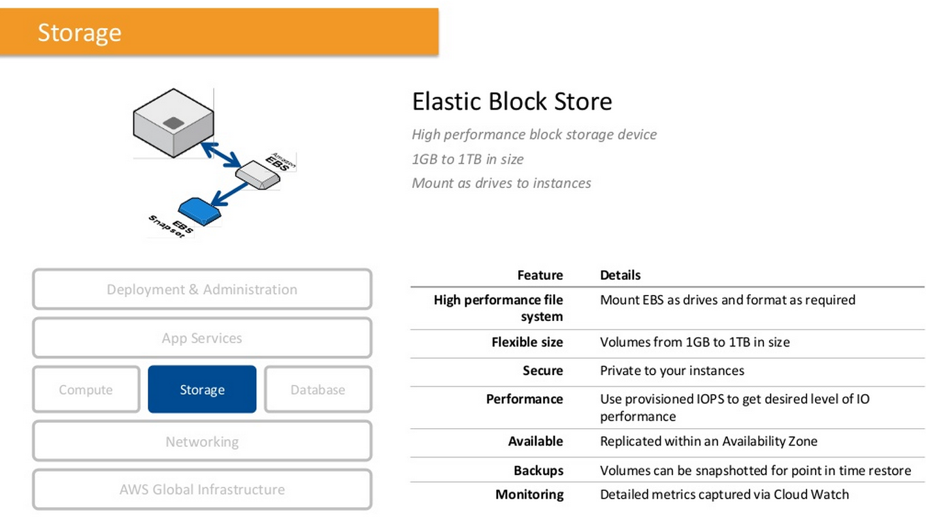
Elastic Block Storage

Slide 29
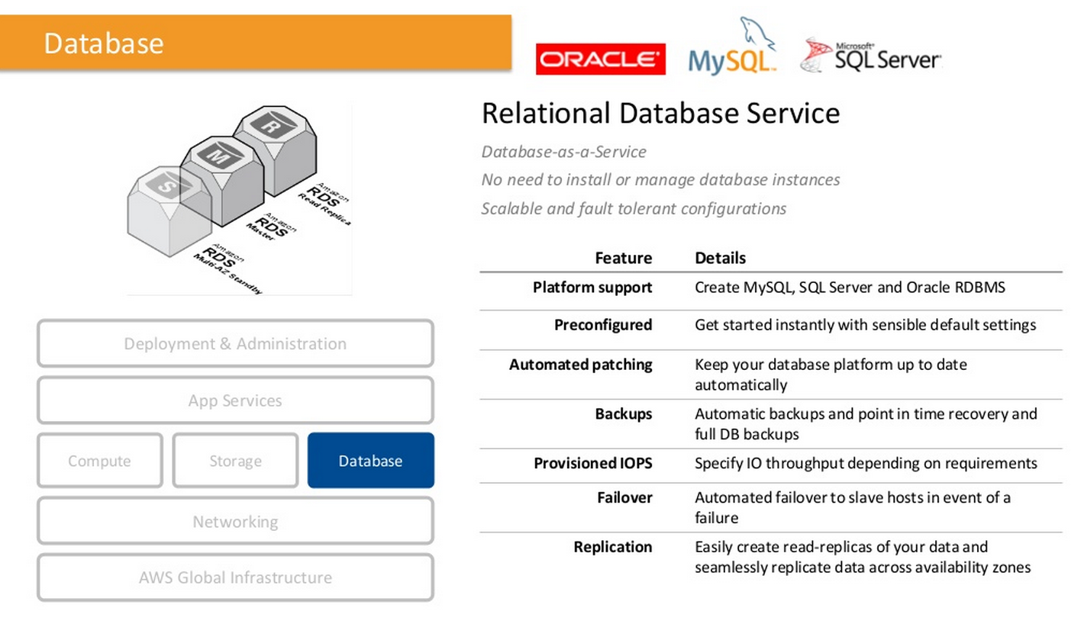
RDS

Slide 30
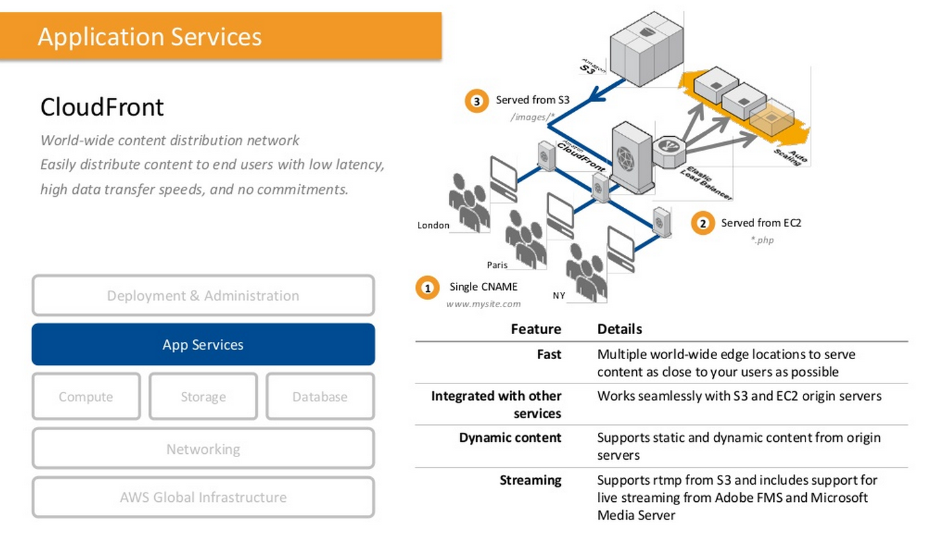
CloudFront

Slide 31
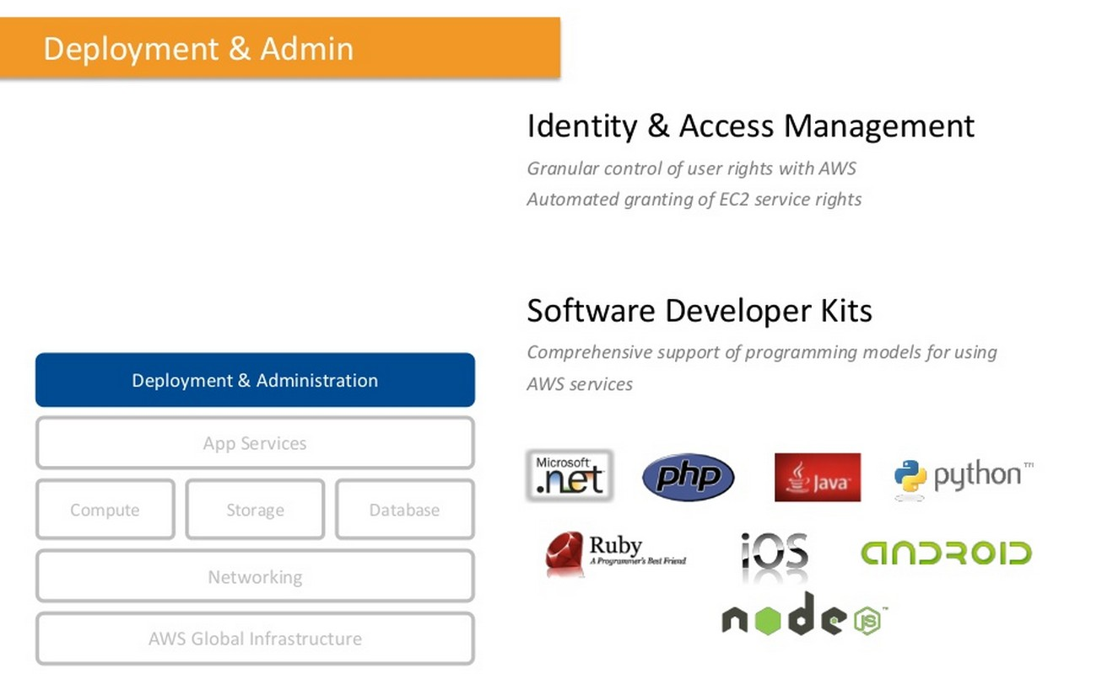
Identity & Access Management

Slide 32
Solutions
Web Applications
Businesses are running Web Applications in the AWS Cloud to lower costs, deploy applications faster and easily scale. AWS customers are using our globally distributed infrastructure to run a variety of Web Applications, everything from small blogs and marketing websites to large, global Web Applications that serve millions of users a day
Gaming :- Using AWS, gaming companies across the globe are running their mobile, social and browser-based games in the cloud to rapidly scale and lower costs. Some of the world’s most popular games, including 8 of the top 10 Facebook games, are running on AWS.
Media Sharing :- Businesses with photo, video and file storage applications are using the AWS Cloud for data storage and delivery. Specifically, businesses are using AWS’s object storage service, Amazon S3. Amazon S3 stores hundreds of billions of objects and is built to store and retrieve any amount of data, at any time, from anywhere on the web. Amazon S3 is designed to provide 99.999999999% durability and 99.99% availability.
Big Data & High Performance Computing
AWS provides scalable infrastructure solutions that businesses can use to cost-effectively store, mine, manipulate and analyze large data sets, aptly termed Big Data. Instead of spending time and resources managing this data, businesses can leverage AWS services. Today, customers are using the AWS Cloud for Big Data projects such as analyzing web logs, analyzing financial services data, and mapping genomes.
AWS is helping scientists and engineers solve complex science, engineering and business problems using High Performance Computing. Instead of waiting in long queues, scientists and engineers can access Amazon EC2 Cluster instances to expedite their HPC workloads and save money.

Slide 33
Solutions Continued….
Enterprise Applications
AWS offers a reliable and secure cloud infrastructure platform that enables businesses to quickly deploy and run enterprise applications. Customers are using AWS to run all types of enterprise applications, from small departmental solutions to mission-critical applications that automate company-wide business processes.
IT departments can build secure and compliant environments in the AWS Cloud to run enterprise applications, including certified software from Oracle, SAP, Microsoft and IBM.
Disaster Recovery & Archive
Disaster Recovery :- Businesses of all sizes are using cloud computing to enable faster disaster recovery of their critical IT systems, without incurring the expenses required to purchase and maintain a second physical datacenter. AWS provides a set of services that enable rapid recovery of your IT infrastructure and data, any time and from anywhere.
Archive :- Using the AWS Cloud for archiving allows businesses to quickly recover business-critical data, while lowering overall costs. AWS uses disk-based storage to deliver fast search and retrieval of data which helps customers recover archived objects in seconds, rather than days or weeks with traditional tape-based archives. Plus, since data is stored in the Cloud, it is instantly available and companies in regulated industries can easily comply with eDiscovery requests.
Backup & Recovery :- Using AWS, businesses no longer have to worry about data management complexity and costs, they can store and retrieve any amount of data, at any time, from anywhere on the web. Plus, with low, pay-as-you-go pricing, businesses only pay for the storage and bandwidth they use and can further reduce costs with tiered pricing by volume.

Slide 34
Thank You !

